Slide 1
CSCI 1101 Introduction to Computer Science
Number Systems

Slide 2
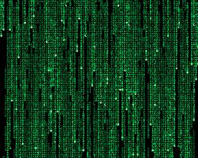
Digital Representation
Inside the computer…
Everything is discrete (digital), not continuous (analog) – i.e, it must be represented using a discrete (number) value
Problem: How do we put the analog world “inside” the digital computer?
Solution: Devise ways to represent real-world, analog data in digital forms
But first… let’s review some ideas about numbers.

Slide 3
Types of Numbers
Natural Numbers
Zero and any number obtained by repeatedly adding one to it.
Examples: 100, 0, 45645, 32
Negative Numbers
A value less than 0, with a – sign
Examples: -24, -1, -45645, -32
We need to be able to represent these different number types in the computer.
Integers
A natural number, a negative number
Examples: 249, 0, - 45645, - 32
Rational Numbers
An integer or the quotient of two integers
Examples: -249, -1, 0, 3/7, -2/5

Slide 4
Natural Numbers
Puzzler:
What does the value 642 mean?
600 + 40 + 2 ?
Or is it
384 + 32 + 2 ?
Or maybe…
1536 + 64 + 2 ?
I know what you’re thinking: “My professor is nuts. Everyone knows what that means.” But DO WE?

Slide 5
Natural Numbers
Aha!
You probably assumed something: which number system we were using!
642 is 600 + 40 + 2 in BASE 10, or in the decimal number system
The base of a number determines the number of digits and the value of digit positions

Slide 6
Positional Notation
Continuing with our example…
642 in base 10 positional notation is:
6 x 10² = 6 x 100 = 600
+ 4 x 10¹ = 4 x 10 = 40
+ 2 x 10º = 2 x 1 = 2 = 642 in base 10
The power indicates
the position of
the number
This number is in
base 10

Slide 7
Positional Notation
What if 642 has the base of 13?
642 in base 13 is equivalent to 1068
in base 10
+ 6 x 13² = 6 x 169 = 1014
+ 4 x 13¹ = 4 x 13 = 52
+ 2 x 13º = 2 x 1 = 2
= 1068 in base 10

Slide 8
The Binary System
The traditional decimal system is based on powers of ten.
The binary system is based on powers of two.

Slide 9
Binary
Decimal is base 10 and has 10 digits: 0,1,2,3,4,5,6,7,8,9
Binary is base 2 and has 2 digits:
0,1
For a number to exist in a given base, it can only contain the digits in that base, which range from 0 up to (but not including) the base.
What bases can these numbers be in? 122, 198, 178, G1A4

Slide 10
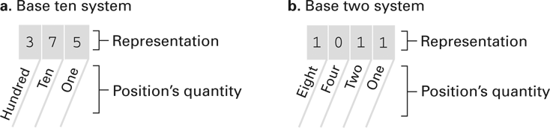
The decimal and binary systems

Slide 11
Converting Binary to Decimal
What is the decimal equivalent of the binary number 1101110?
1 x 2⁶ = 1 x 64 = 64
+ 1 x 2⁵ = 1 x 32 = 32
+ 0 x 2⁴ = 0 x 16 = 0
+ 1 x 2³ = 1 x 8 = 8
+ 1 x 2² = 1 x 4 = 4
+ 1 x 2¹ = 1 x 2 = 2
+ 0 x 2⁰ = 0 x 1 = 0
= 110 in base 10
Or, another way to look at it…

Slide 12
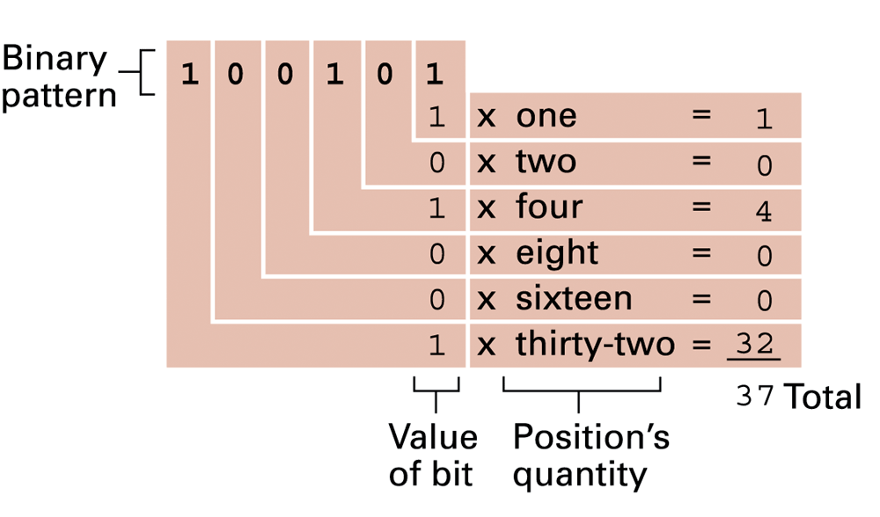
Decoding the binary representation 100101

Slide 13
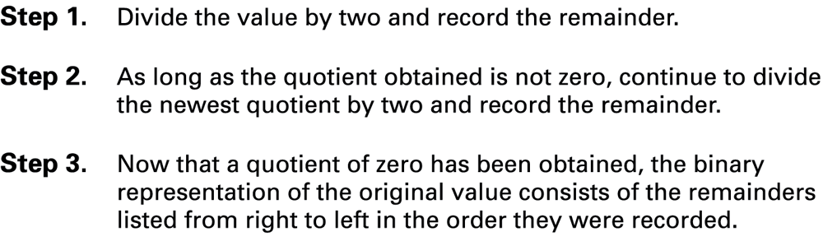
Converting Decimal to Binary
This algorithm is generalizable. Just divide the decimal value by ANY new base to find the decimal equivalent in the new base!

Slide 14
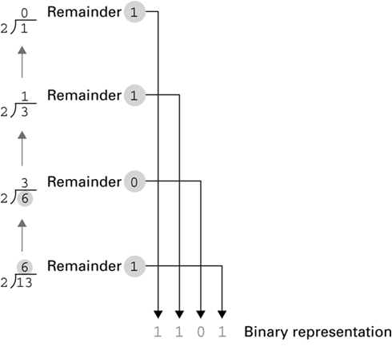
Applying the algorithm to obtain the binary representation of 13₁₀
Start here

Slide 15
Bases Higher than 10
How are digits in bases higher than 10 represented?
With distinct symbols for 10 and above.
Base 16 – hexadecimal – has 16 digits:
0,1,2,3,4,5,6,7,8,9,A,B,C,D,E, F
Why would we use such a strange base??

Slide 16
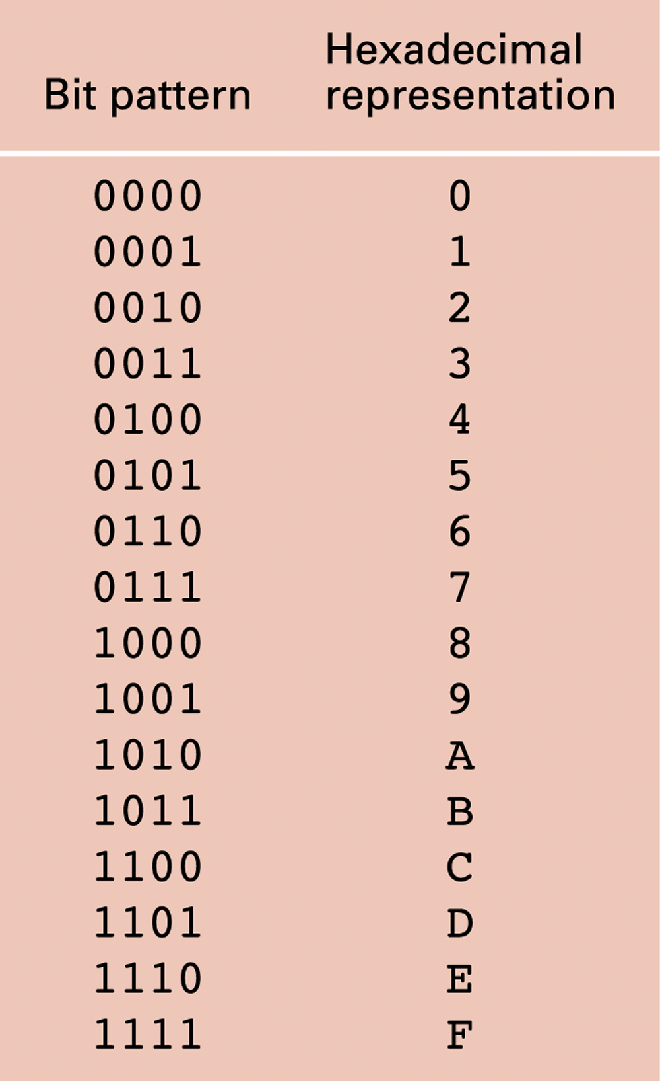
Hexadecimal and Binary are Related!
Converting hexadecimal to binary is easy:
Just convert the hex digit to the corresponding binary digits (bits)
1 hex digit = 4 bits

Slide 17
Converting Binary to Hexadecimal
Mark groups of four bits (starting at the right end)
Convert each group of bits into hex digits
10101011 1010 1011
A B
10101011 is AB in hexadecimal

Slide 18
Converting Hexadecimal to Decimal
What is the decimal equivalent of the hexadecimal number DEF?
D x 16² = 13 x 256 = 3328
+ E x 16¹ = 14 x 16 = 224
+ F x 16º = 15 x 1 = 15
= 3567 in base 10
Remember, the digits in base 16 are 0,1,2,3,4,5,6,7,8,9,A,B,C,D,E,F
It’s still just positional notation

Slide 19
Converting Decimal to Hexadecimal
What is 3567 (base 10) in base 16?
Use the algorithm from a few slides back (slide #12), dividing by 16 instead of 2
Try it!

Slide 20
Converting ANY Base to Decimal
To convert from ANY base to base 10:
Use the positional notation for the corresponding base.
Given a number in base B, to convert to base 10 use:
(d_{n}. . .d₂ d₁ d₀)_{B} = d_{n}xB^{n} + . . . + d₂xB² + d₁xB¹ + d₀xB⁰
= (Value)₁₀

Slide 21
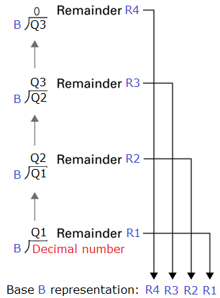
Converting Decimal to ANY Base
To convert from base 10 to ANY base:
Use the algorithm presented in slide 12 modified for the corresponding base.
Given a number in base 10, to convert to base B use:

Slide 22
Why the Obsession with Binary and Hex?
Computers have storage units called binary digits or bits
The computer operates with voltage through what amounts to microscopic switches that are either “on” (1) or “off” (0)
Low Voltage = 0
High Voltage = 1 all bits have value 0 or 1

